Slide 1



Cranium Cafe
Crash Course

Slide 2
Cranium Cafe
Cranium Cafe is an internet based platform that will allow you to have access to the VRC staff during this unexpected occurrence.
This brief presentation is a basic guide to get you started.
Once you are logged on, you can then reach out to any one of our VRC staff via Cranium Cafe to assist you during this period.
Lets begin!

Slide 3
Getting Started
The first thing you need to do is go to the link below…
https://sac.craniumcafe.com/login

Slide 4
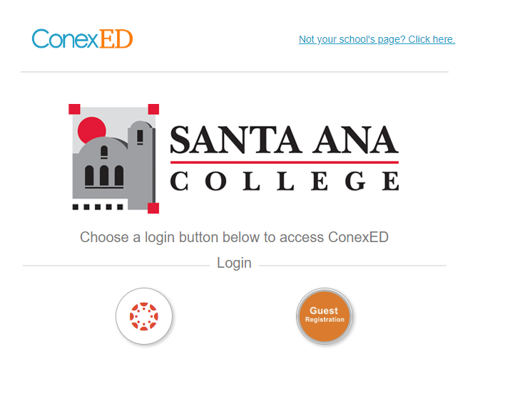
Getting Started
You should see this screen.
Click on the Canvas icon and you should
then be able to log in.

Slide 5
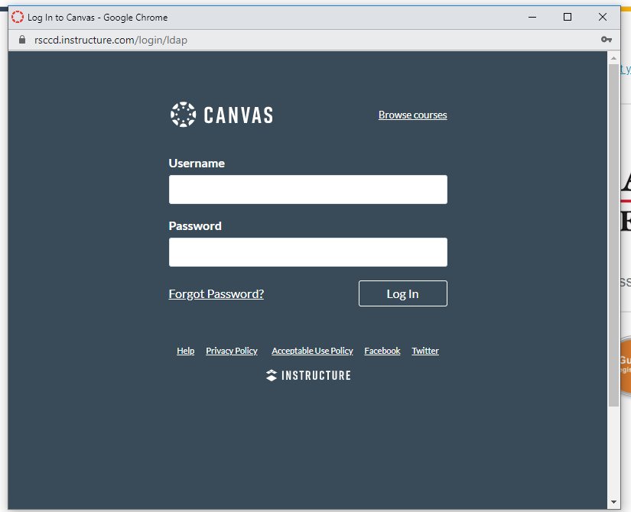
Logging In
You should see this screen.
To log in, use your Webadvisor
Username and password.

Slide 6
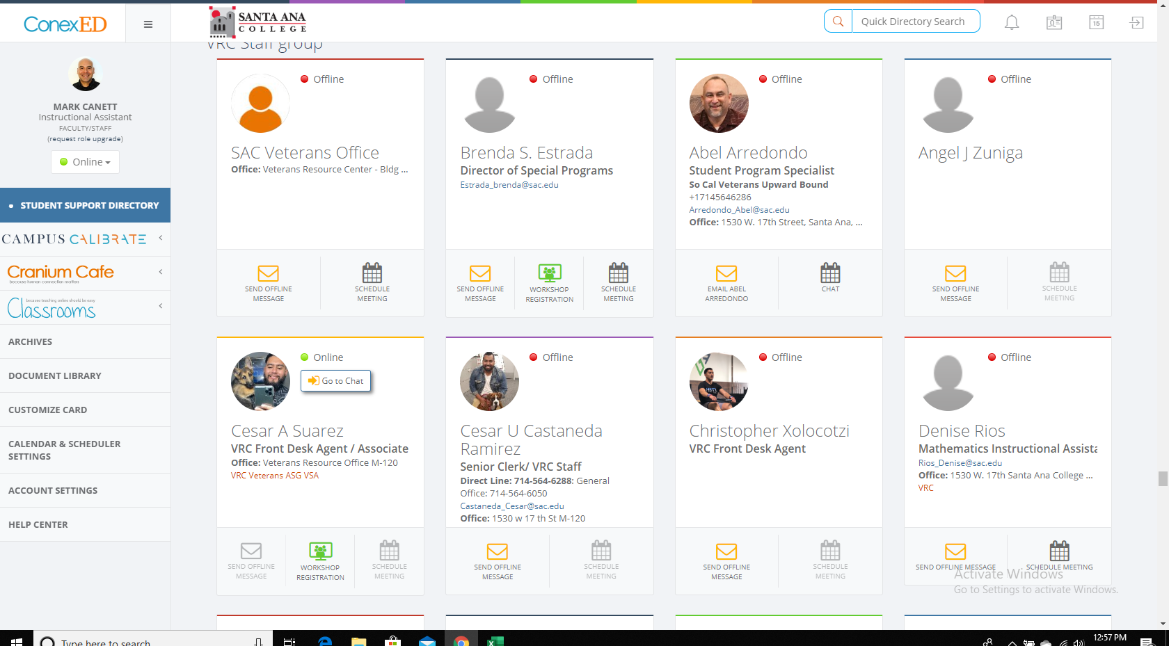
Once you are logged in...
not only will you have access to VRC staff, but all the other staff members that are awaiting to help you during this time.

Slide 7
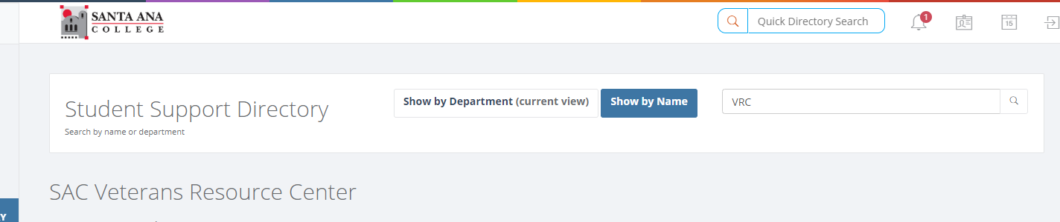
Getting Directly to the VRC Staff
At the top of the page you will see the Student Support Directory.

Slide 8
Chatting with Staff
Once you have located the staff member whose attention you seek, you can chat with them by clicking the icon that either reads Chat or Knock on Door. They will then be with you shortly.

Slide 9
Scheduling Appointments
You can also make an appointment with a staff member such as an Academic Counselor or Instructional Assistant. Simply click on the Make an Appointment icon at the bottom of the staff person’s card, and set your appointment.

Slide 10
We hope this was helpful.
Please feel free to email one of your Instructional Assistants, Mark Canett if you have difficulty or need further guidance getting started on Cranium Cafe. If not, then you should be ready to begin contacting your VRC staff members when needed.
Canett_mark@sac.edu

